Slide 1
Agile Development
Topic 5:
Lifecycle and Products
Notes:
NCC Education - Title Master

Slide 2
Topic 5 Coverage
This topic will cover:
  The lifecycle
  The phases
  The products
Notes:
The lifecycle management is key to ensuring that an Agile Project is managed effectively. This Topic will explain the lifecycle process, the phases and the product.

Slide 3
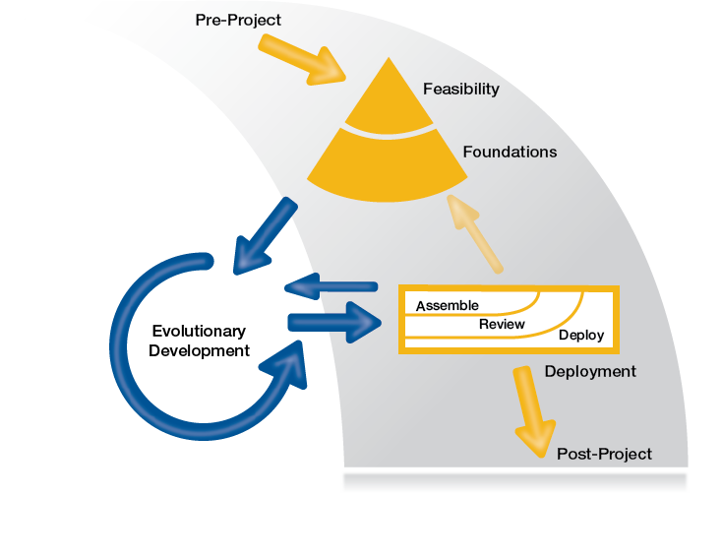
The DSDM Lifecycle - 1
Source: Image from dsdm.org © 2016
Notes:
As detailed in Topic 1, the DSDM Agile approach lifecycle is more dynamic than the Traditional Waterfall Lifecycle approach.
Each phase can be defined as follows:
Pre-Project Phase - In line with the DSDM Philosophy
“that best business value emerges when projects are aligned to clear business goals”, the Pre-Project phase ensures that only the right projects are started, and that they are set up correctly, based on a clearly defined objective.
Feasibility Phase
The Feasibility phase is intended primarily to establish whether the proposed project is likely to be feasible from a technical perspective and whether it appears cost-effective from a business perspective.
Foundations Phase
The Foundations phase takes the preliminary investigation from Feasibility to the next level. It is intended to establish a fundamental (but not detailed) understanding of the business rationale for the project, the potential solution that will be created by the project, and how development and delivery of the solution will be managed. This phase concentrates on the high level detail and does not cover the low level detail required in more in-depth phases. It may sometimes be necessary to revisit Foundations after a Deployment phase. The decision to revisit Foundations may be planned in from the start of the project; for example, on a project where the business environment is sufficiently dynamic that the Foundations are expected to encounter significant change during the life of the project. Alternatively, the decision to revisit Foundations may be taken after a Deployment has produced an unexpected outcome.
For smaller, simpler projects, the Feasibility and Foundations phases can often be merged into a single phase.
The aim of Foundations is to understand the scope of work, how it will be carried out, by whom, when and where. The Foundations phase also determines the project lifecycle by agreeing how the DSDM process will be applied to the specific needs of this project.
Evolutionary Development Phase
Building on the firm foundations that have been established for the project, the purpose of the Evolutionary Development phase is to evolve the solution.
The Evolutionary Development phase requires the Solution Development Team(s) to apply practices such as Iterative Development, timeboxing, and MoSCoW prioritisation, together with Modelling and Facilitated Workshops, to converge over time on an accurate solution that meets the business need and is also built in the right way from a technical viewpoint.
Working within Timeboxes, the Solution Development Team create Solution Increments, iteratively exploring the low-level detail of the requirements and testing continuously as they move forward.
Deployment Phase
The objective of the Deployment phase is to bring a baseline of the Evolving Solution into operational use. The release that is deployed may be the final solution, or a subset of the final solution.
Some examples of what can be deployed are:
Business change - introducing a new way of working into a factory (deploying a business change as a single release)
The early deployment of a corporate intranet, providing a limited number of features, with more features to be provided later (deploying the first release of many)
A complex product - e.g. the launch of a new mobile phone, bringing together par ts of the solution from multiple projects run in different locations (deploying a new product as a single release)
The Deployment phase comprises three main activities: Assemble, Review and Deploy. In addition, after the last release, the project is formally closed.
Assemble
Before a physical deployment, there are usually activities that take place to ensure that what is being delivered is coherently. This may also include bringing together any relevant supporting information.
Review
Once all the elements of a release have been assembled, in most circumstances there will be some form of “approval to deploy”. This will be based on a final review of the solution before it goes into operational use - to ensure the proposed release meets the appropriate standards and is complete enough to be viable. 6.6.3 Deploy
Once approval has been given, Deploy is the physical act of putting what has been assembled (the release) into operational use. It includes any technical work, such as transfer of the solution into the live (production) environment, but also the enactment of any plans for business change.
Closing the project
After the final Deployment, the project is formally closed. At this point, the whole team hold a retrospective to review the overall project performance, both from the technical and/or process perspective and from the business perspective.

Slide 4


Exercise 1
You are now going to be put into groups of 7. Once in your groups you need to all choose a role:
    Analyst
    Designer
    Developer
    Tester
    User Acceptance Tester
    Implementer
    QA/Timekeeper
Each team will work directly in competition with the other team(s)
Notes:
For this exercise, you will need 20 coins for each team (the teams may provide their own or you can supply them); a timer for each team (one team member with a watch will do) and a whiteboard/flipchart.
Divide the group into teams of seven.
Each team forms a straight line against a cleared table
The coins are placed in a heap at one end of the table.
DSDM ATERN
Modelling
ATERN S2 modelling

Slide 5
Exercise 1
Pass 1: The Waterfall Way
Timed by the timekeeper, the coins are first turned to all “heads” by the analyst, and passed as a batch to the designer.
The designer turns them all to “tails” and passes them as a batch to the developer, and so on down the line until the implementer has taken their turn and shouts “Stop”.
At this point the timekeeper records the time on the whiteboard/flipchart. The timekeeper turns no coins but acts as quality control to ensure there was no cheating.
Notes:
DSDM ATERN
Modelling
ATERN S2 modelling

Slide 6
Exercise 1
Pass 2: The Agile Way
This time, the roles still operate in the same way, but as soon as one coin is turned it can be passed to the next role, rather than waiting for a batch to be completed.
Again the timekeeper watches quality and times the event, and records the time as before when the implementer shouts ‘Stop!’
Notes:
Outcome: the time taken should be significantly shorter with the Agile way.
The teaching points to draw out of this activity are that Agile works faster if resources are dedicated. Waterfall resourcing requires people to be on many projects simultaneously. Waterfall can waste considerable time waiting for phases to be completed before further progress can be made.
DSDM ATERN
Modelling
ATERN S2 modelling

Slide 7
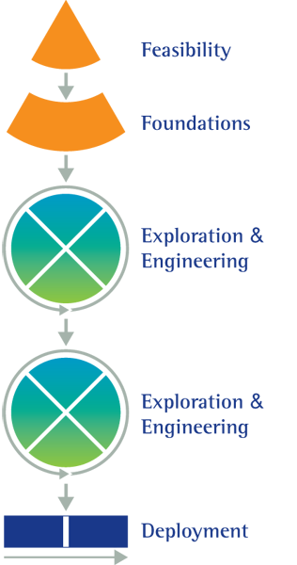
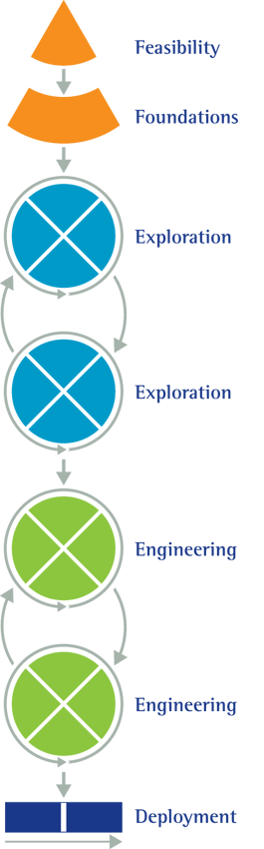
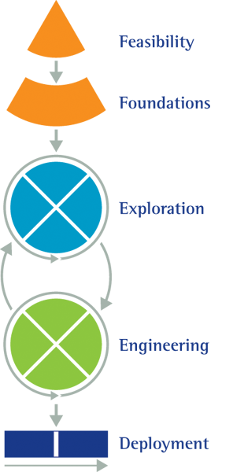
Configuring the DSDM Lifecycle - 2
Feasibility
Source: Image from dsdm.org © 2016
Notes:
DSDM ATERN
DSDM Life Cycle and Products
ATERN S4 lifecycle
(C) DSDM Consortium 2007
Dependent on the project, the lifecycle can bend and stretch to meets its needs. The cross shown in the Exploration and Engineering blocks shows that this is being managed as a timebox. It is common in Agile projects to overlap Exploration and Engineering phases in one timebox, as shown in the central diagram.
The products of Engineering are just an evolution of the Exploration products. However, there is still detailed analysis (Exploration) to be done, timebox by timebox, on the functionality, before code is built during the Engineering phase.

Slide 8
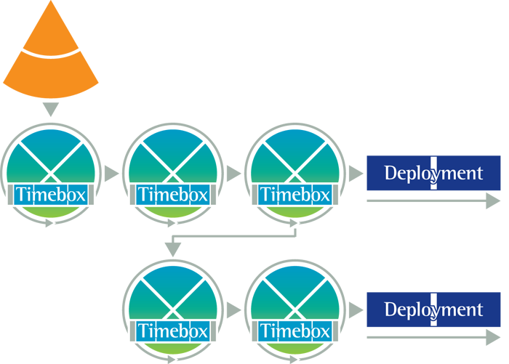
The DSDM Lifecycle - 3
Feasibility
Source: Image from dsdm.org © 2016
Notes:
DSDM ATERN
DSDM Life Cycle and Products
ATERN S4 lifecycle
(C) DSDM Consortium 2007
Here we can see an example of where the Exploration and Engineering are combined in timeboxes. It shows that there may initially be 3 timeboxes set and then the product may be ready for deployment, or it may be that there are still improvements/enhancements to be made and further timeboxes are added to ensure the final product meets the requirements of deployment.

Slide 9
Structure of the DSDM
Lifecycle Products
Business
Focus
Solution
Focus
Management
Focus
Pre-project
Feasibility
Foundations
Exploration
Engineering
Deployment
Post-project
Notes:
During each phase of the lifecycle there is a focus on three aspects:
Business: This covers vision and cost-benefit justification aspects
Solution: This covers the evolving solution and the documentation to support this
Management: This covers the planning and control of the project

Slide 10
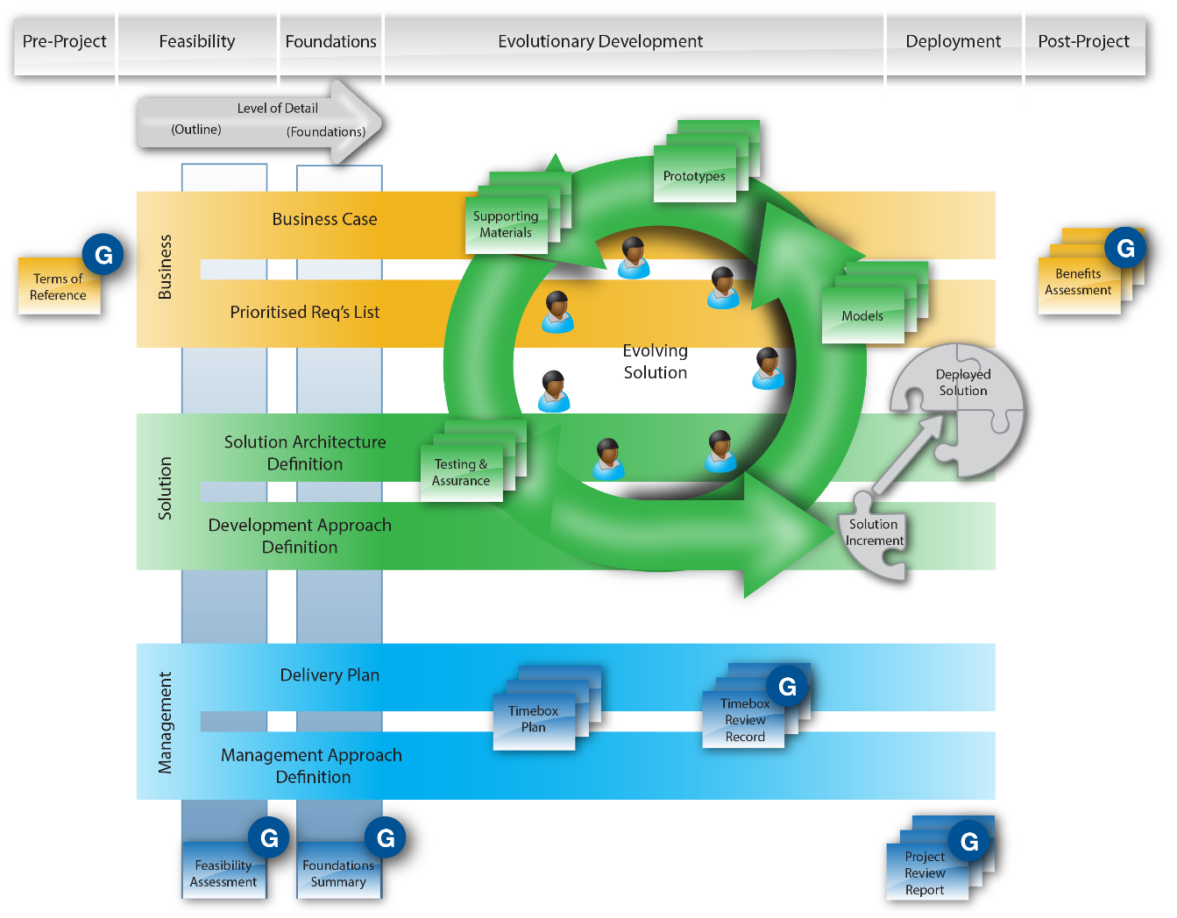
Product Overview
Orange = Business focused,
Green = elements that contribute to the Solution
Blue = Project management/ control interests.
Products with a ‘G’ may also play a part in governance processes
Source: Image from dsdm.org © 2016
Notes:
In DSDM, there are a set of products that need to be considered as the project proceeds. These products describe the solution itself (the main deliverable of the project) and anything created to help with the process of evolving it, and anything that is required to help with project governance and control.
Not all products are required for every project and the formality associated with each product will vary from project to project and from organisation to organisation.
DSDM identifies two distinct types of product:
Evolutionary products evolve over time. They typically, but not always, span a number of project phases and may be baselined more than once during that time.
Milestone products are created in a phase and typically fulfil a specific purpose within that phase as a checkpoint or to facilitate governance processes.
Products commonly included are:
Terms of reference
Business Case
Prioritised Requirements List
Solution Architecture Definition
Development Approach Definition
Delivery Plan
Management Approach Definition
Feasibility Assessment
Evolving Solution
Timebox Plan
Timebox Review Record
Project Review Report
Benefits Assessment
For the latest detailed information relating to Products students should be encouraged to view the latest DSDM Handbook on the DSDM Consortium Website www.agilebusiness.org website.

Slide 11
Summary of Lifecycle and
Products – 1
  Points to consider are:
  The lifecycle – Agile by design, it can be changed and manipulated to meet the projects specific evolutionary needs.
  The phases – Each phase of the lifecycle will involve meeting set objectives that will impact on other phases.

Slide 12
Summary of Lifecycle and Products – 2
The products – As the project progresses there will be products created, ultimately documentation, such as; Terms of reference, Business Case, Solution Architecture Definition, Development Approach Definition, Delivery Plan, Feasibility Assessment etc.

Slide 13
Summary of Lifecycle and Products – 3
The products overview
Terms of reference – High level requirements that dictate the feasibility phase
Business Case – Evolving tool to enable the business needs to be documented
Solution Architecture Definition – Evolving high level design specifications

Slide 14
Summary of Lifecycle and Products – 4
The products overview
Development Approach Definition – High level definitions regarding the process, people, resources required for the design phase
Delivery Plan – Evolving high level schedule
Feasibility Assessment – Used as a milestone product to provide a snapshot of other evolving products
Notes:
There are further products and more detail that will come out during the Private Study exercises. You will visit these during the tutorial for this topic.

Slide 15
SCRUM Products = Artefacts
SCRUM artefacts (products)
  Product Backlog - this is ultimately a full list of requirements, but is never complete. The Product Manager will re-visit this continuously and add to it.
  Sprint Backlog – SCRUM uses ‘Sprint’ cycles as DSDM uses Timeboxes. Sprint Backlogs are the requirements for each Sprint, that ultimately make up a single increment.
Notes:
SCRUM has slightly different management of the lifecycle and artefacts (products). SCRUM brings all artefacts together into backlogs. There are main Product backlogs and then Sprint backlogs for each increment. One Product Manager has overall responsibility, but may delegate Sprint backlogs to others in the team.

Slide 16
Topic 5 – Lifecycle and Products
Any Questions?
Notes:
NCC Education - End Slide Master

